Slide 1



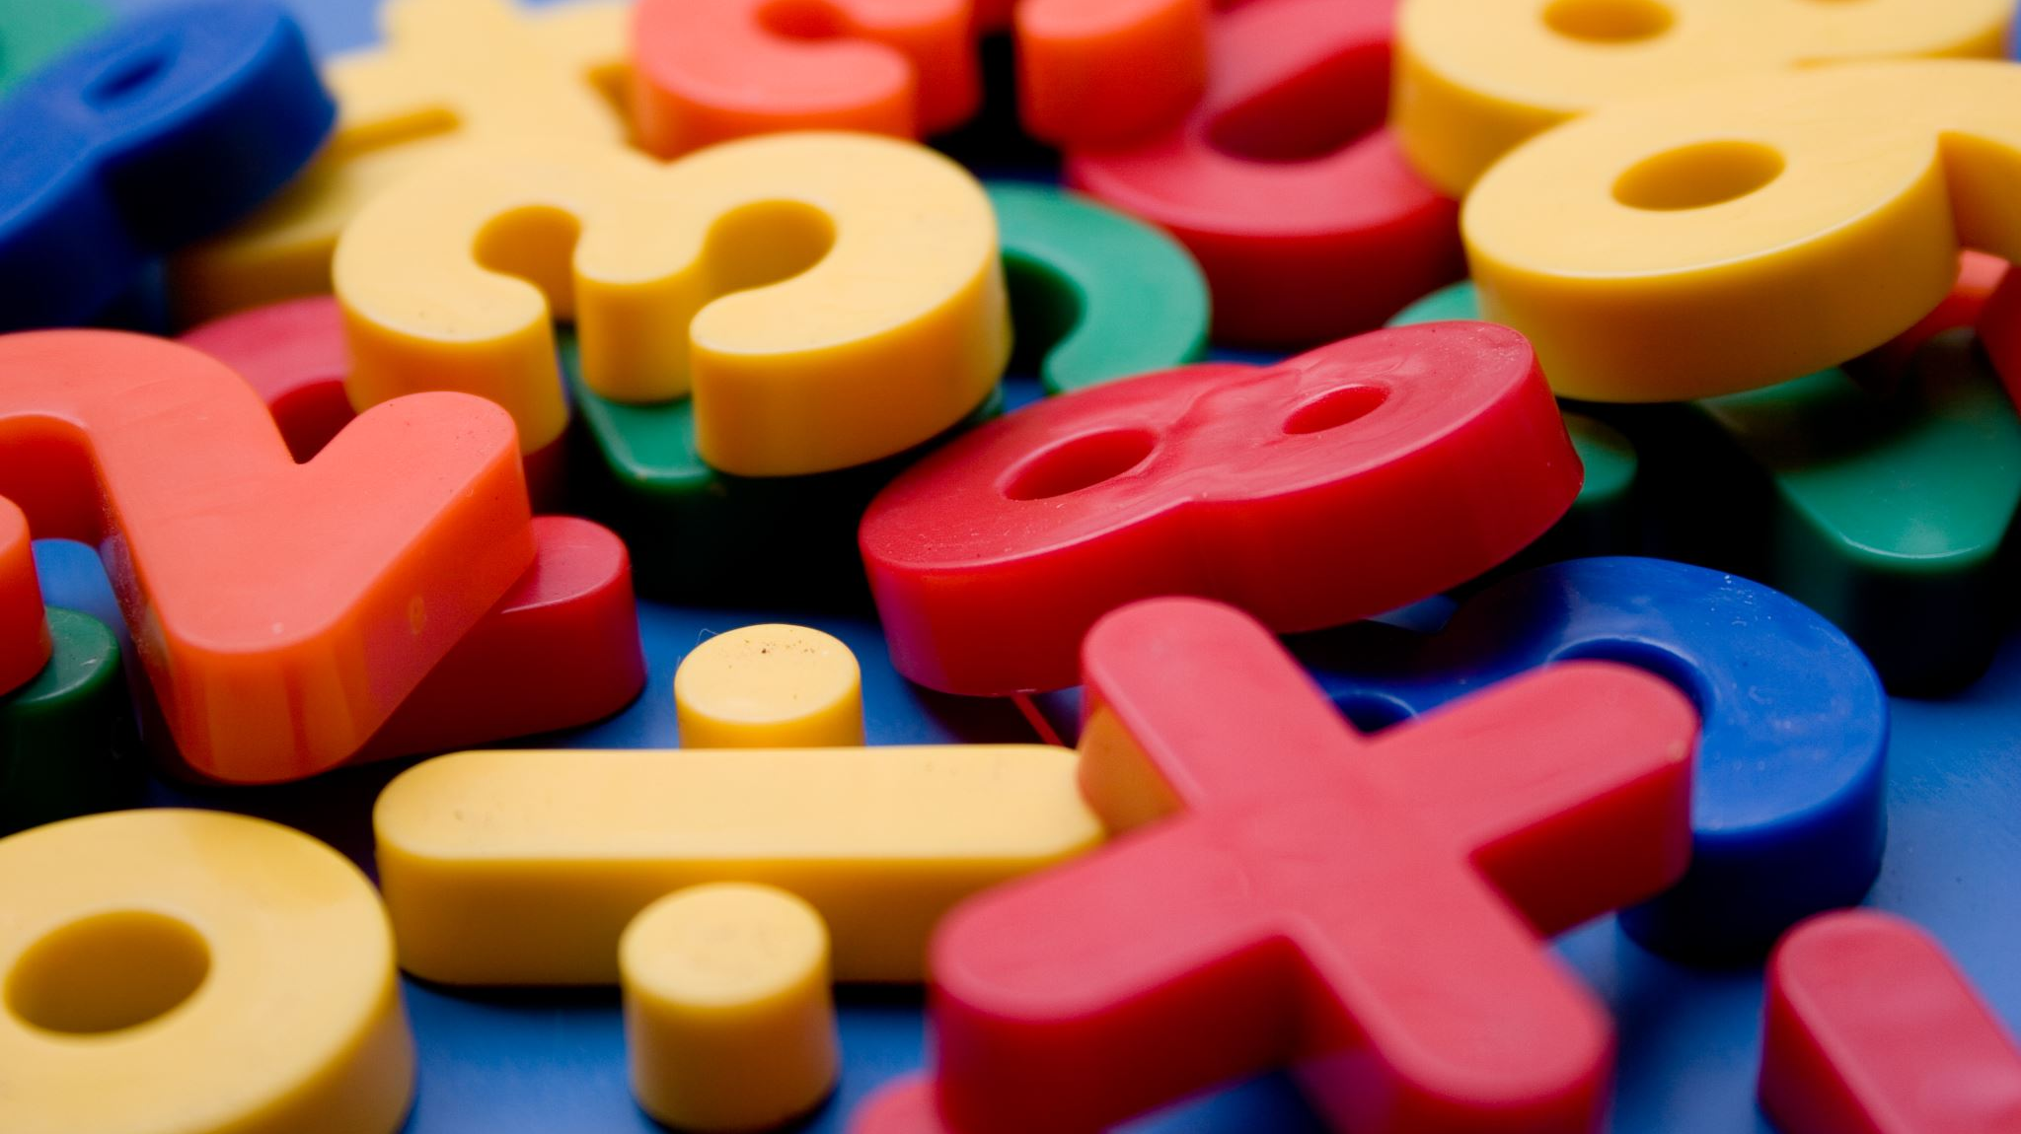


Maths at Bridlewood

Slide 2
Maths at Bridlewood
Maths culture
Teaching for Mastery
What our children learn and how
How to help at home

Slide 3
Attitudes towards Maths
It is culturally acceptable in the UK to be negative about maths, in a way that we don’t talk about other life skills. We hear ‘I can’t do maths’ so often it doesn’t seem a strange thing to say (Kowsun, 2008).
This attitude can have a big impact on children’s confidence and resilience in Maths.
Growth mindset and enjoyment

Slide 4
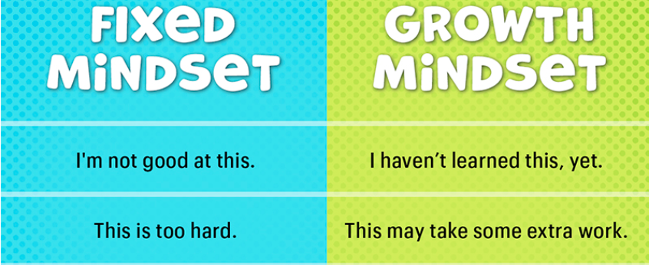
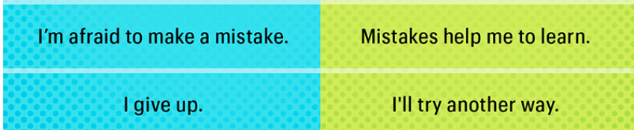

Slide 5

Teaching for Mastery
Maths mastery is a teaching and learning approach that aims for pupils to develop deep understanding of maths rather than being able to memorise key procedures or resort to rote learning.

Slide 6
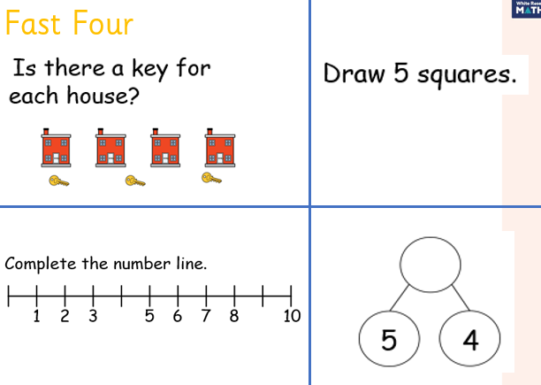
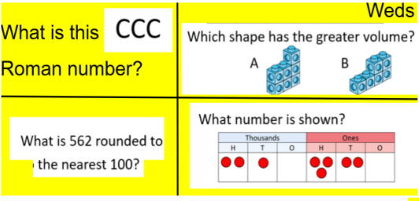
Remembering More

Slide 7
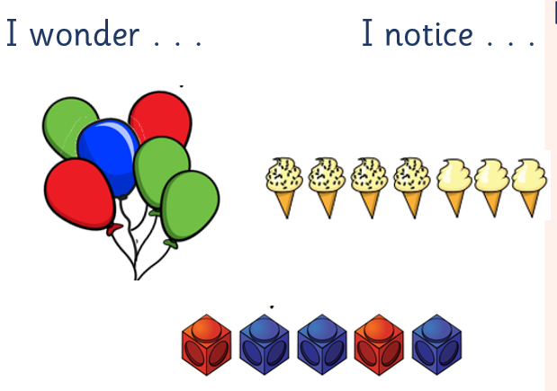
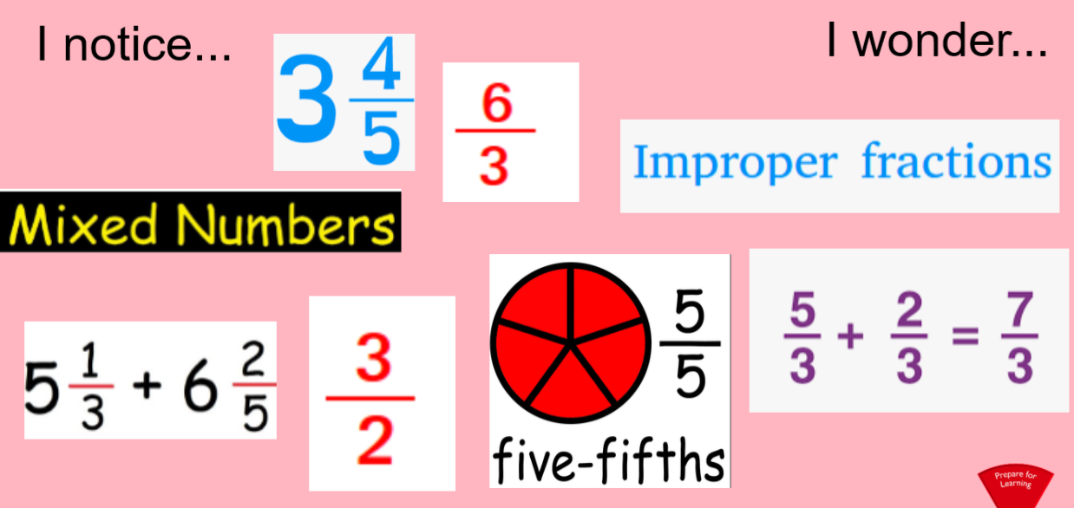
Maths Talk in the Classroom
E.g. Notice Wonder

Slide 8

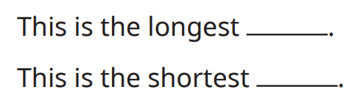




Maths Talk in the Classroom

Slide 9
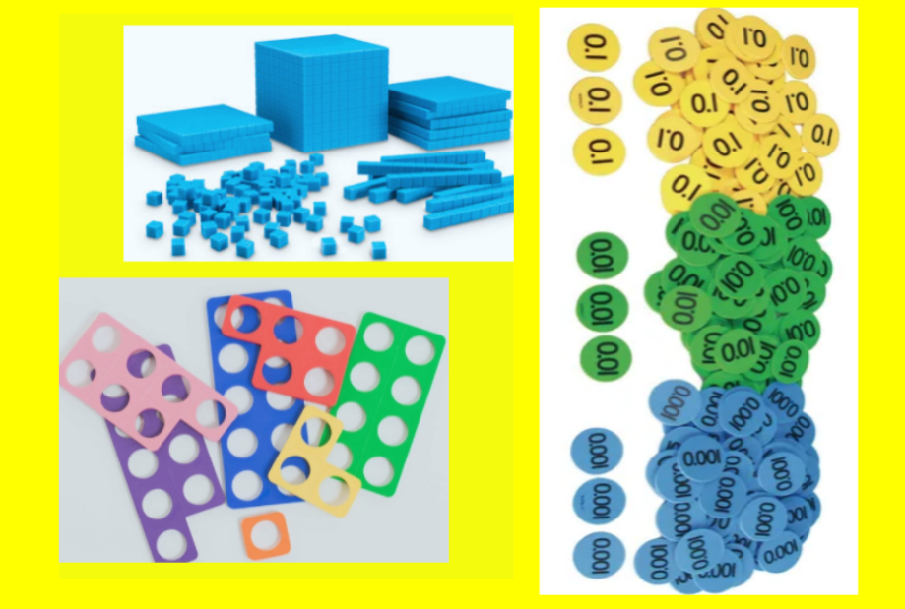
Manipulatives
E.g. Notice Wonder
Not a crutch
Model learning

Slide 10
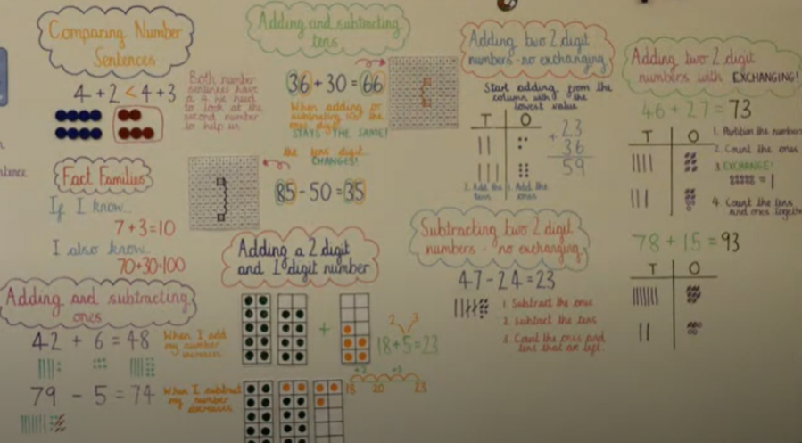
Working Walls

Slide 11
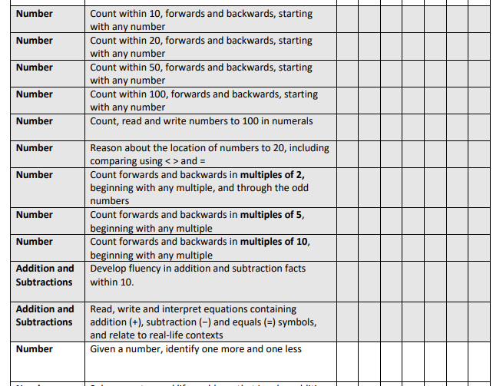
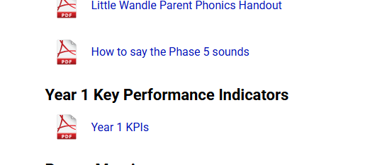
Key Performance Indicators

Slide 12
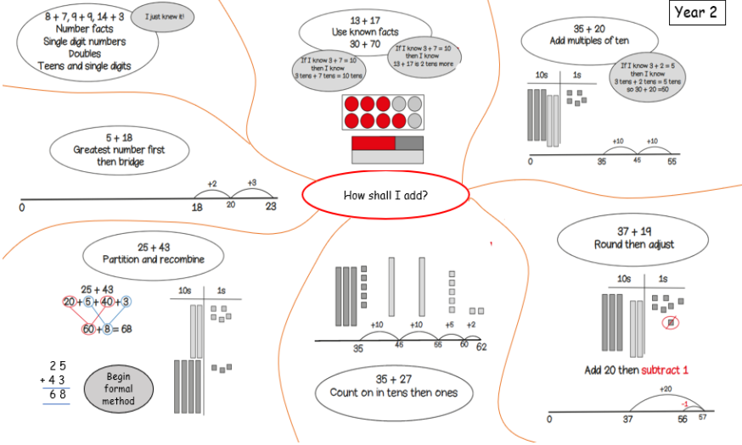
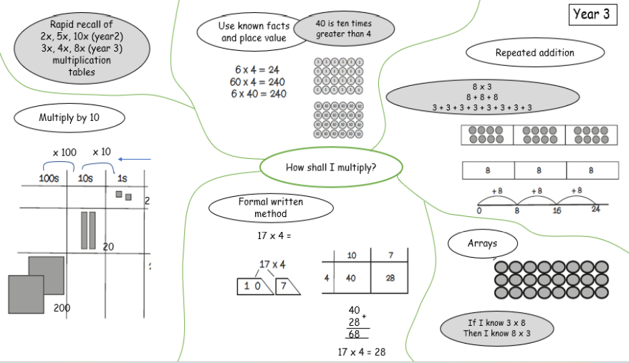
Calculation Policy

Slide 13
How to support your children at home
Board games
Every day routines - counting, comparing, time and sharing.
Mathematical vocabulary as part of conversations and play - Which is bigger? Who is first in line? Who has more? Are they shared fairly?
Shape spotting
Finding the mathematics in story books –counting / comparing
Use manipulatives - building bricks could be used to model simple addition and multiplication.
Measuring items, using scales
Puzzles

Slide 14

Times Tables Rockstars
Online learning platform to support the children's recall of number facts.
A good recall of times tables frees up working memory.

