Slide 1
Welcome to Elm Class
Year 3
Miss Sykes
Mrs Smedley
Mr Williams

Slide 2

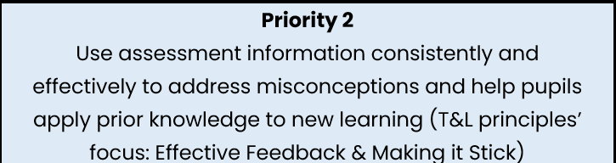

Whole School Priorities 2026 - 27
We have ambitious targets in order to continuously improve.
Our main school development priorities for this academic year:
The full School Development Plan for 2026-27 will be available on the school website shortly.
Notes:
TPAT teaching and learning principles - These six foundational principles which outline effective teaching strategies.
OPAL - An OPAL school refers to a school that participates in the Outdoor Play and Learning Primary Programme. This program is designed to improve the quality of playtimes for children by transforming playgrounds and play practices within schools.

Slide 3

PE:
  Tuesday and Wednesday
Full PE kit worn to school
PLAIN white t shirt; BLACK shorts, leggings or tracksuit bottoms; GREEN Bridlewood hoodie/Jumper
No jewellery – earrings must be removed or covered
Hair tied back
Trainers
* No trainers or hoodies on days other than PE days

Slide 4

Homework:
Set through Class Dojo
Set on Thursday
Handed in on Tuesday
Maths
TTRS
Regular reading
Stamp for 20 reads
Spelling test on Friday
Notes:
Emphasis on Reading being important even as children get older – fluency in Reading will support comprehension/understanding and affects all other subjects so it is important to emphasis – it is embedded in the detail of our SDP target on TPAT teaching and learning principles.

Slide 5


Equipment:
Water bottles
No pencil cases or toys
Wellies, rain coat
Notes:
No mobile phones until Y5/6
if a child in year 5/6 is walking alone and they want them to have a phone then this is switched off once on the school site and handed in to their teacher.

Slide 6

Behaviour:
Bridlewood Core Values Park Academies Trust Values:
Children and parents are
expected to conduct
themselves in a manner
fitting to these values
Responsibility
Respect
Honesty
Courage
Respect
Integrity
Ambition

Slide 7


Smile, verbal praise (‘well done’), thumbs-up.
Stickers and team points.
Star of the day.
Positive feedback to parents.
Eating with the headteacher at the ‘top table’ for positive lunchtime behaviour.
Weekly celebration assembly certificates and awards.
Termly behaviour awards: Bronze, silver, gold and platinum star award badges given to pupils who consistently demonstrate our school values.

Slide 8

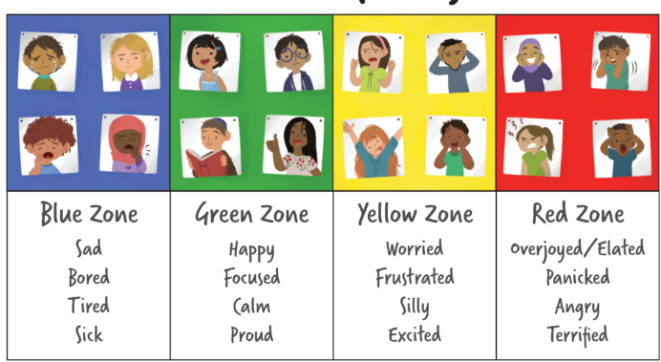
- We use the Zones of Regulation as the first approach in preventing and addressing unwanted behaviours or dysregulated emotions.
We recognise that self-reflection is the key to ensuring poor behaviour is addressed in the most appropriate way.
The Zones of Regulation provide an easy way to think and talk about how children feel on the inside and sorts emotions into four coloured Zones.

Slide 9




Adults notice the dysregulated behaviour, help the pupil label their emotion/zone they are in and provide opportunities for them to calm down and regulate.
If the unwanted behaviour continues, the pupil will receive a reminder from the class teacher/adult. The pupil is encouraged to use Zones of Regulation strategies to manage their emotion.
If the unwanted behaviour continues the pupil will receive a reminder that unless they regulate their behaviour, they will spend some time during the next playtime to reflect on their choices. Adults will direct the pupil to use the Zones of Regulation strategies to help them regulate their behaviour and pupils are offered a brain break in the nurture room or snug or to go to another classroom to continue their learning.
.

Slide 10


Step 4- If the pupil is unable to regulate their behaviour they will be directed to have a restorative conversation with a member of senior staff during the next playtime to reflect on their behaviour choices. Parents/carers are informed at the end of the day.
Step 5- If the unwanted behaviour continues, the pupil and class teacher meet with the SENDCo or Headteacher and parent and a behaviour target is agreed. The pupil’s behaviour is then monitored for a number of days. The class teacher gives feedback to the pupil and the parent/carer on whether or not they have met their behaviour target.

Slide 11

Home School Agreement
Notes:
In the home school agreement emphasise the role of supporting safe and secure internet use outside of school as many incidents in school particularly older children can come from their behaviour online at home.

Slide 12

Assessments
Assessment
Daily on-going assessments
Reading, Spelling and Grammar, Maths
Writing is teacher assessed

Slide 13
Illness
Sickness – 48 hour rule
Children with high temperature should not attend
Keep up with hand washing and respiratory hygiene
Phone or email before 9am on each day of illness to inform school
admin@bridlewood.org.uk 01793 706830

Slide 14
Asthma
If your child is registered as having asthma please email Mrs McLaughlin so they can be added to the asthma register.
McLaughlinN@bridlewood.org.uk

Slide 15
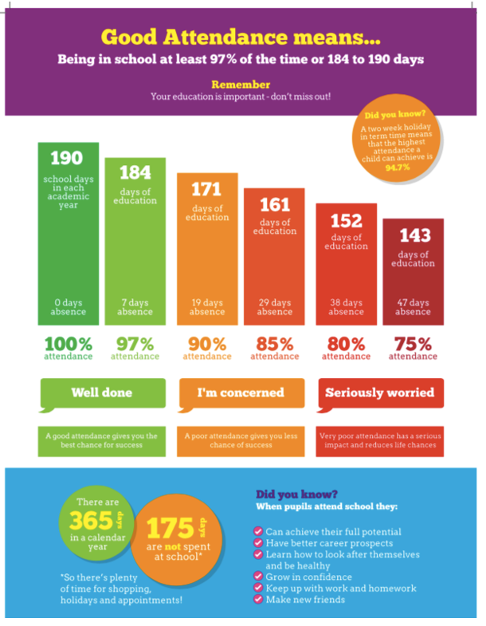
Attendance
No entitlement for holidays unless special circumstances requested in advance with Mrs Sammon – forms from the school Office.
Attendance for Bridlewood was 94.7% last year.

Slide 16

Curriculum Information
Curriculum yearly outline
Current term’s topic map
Typical weekly class timetable
Weekly/year group spelling lists
Assessment targets (KPIs)
All on the website’s class page:

Slide 17
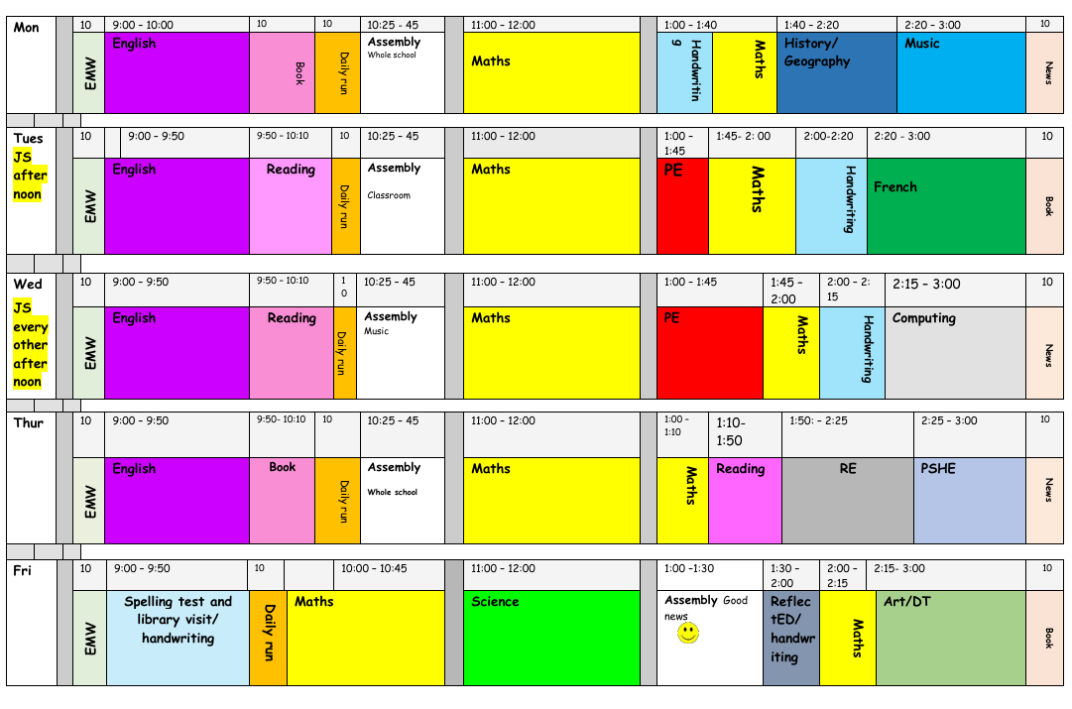

Notes:
Handwriing
Reflect Ed
Afternoon maths

Slide 18


The Parks Academies Trust has developed a TPAT Pledge linked to four core values: respect, courage, ambition and integrity.
This pledge is to every child. During their time in year 6, your child will be given the opportunity to take part in the following activities.
In addition to this look out for other enrichment opportunities.
Notes:
https://www.bridlewoodprimaryschool.org.uk/enrichment/
Pledge posters are on the website
Pledge – emphasise that this is the core and that at Bridlewood we offer many and varied opportunities for clubs, sporting, music and other events and competitions, charity events, trips, discovery days and school leadership roles.

Slide 19

Key Diary Dates Term 1:
After School Clubs Start – 14/9/26
Plas Pencelli Residential – 28/9/26 – 2/10/26
Doing it for Dan Run – 6/10/26
Individual and Sibling Photos - 7/10/26
Harvest Assembly – 9/10/26
Coleshill Trip – 19/10/26
Black History Discovery Day – 20/10/26
Parent Consultations – 14/10/26 *Early finish
INSET day – 23/10/26
Notes:
KS1 Maths meeting is 2/10/25

Slide 20

Help from parents:
Encourage your child to read regularly
Help practise weekly spelling
Check homework is in on time
Support on trips / Dan Run
sykesc@bridlewood.org.uk

Slide 21

Any questions?

